Slide 1
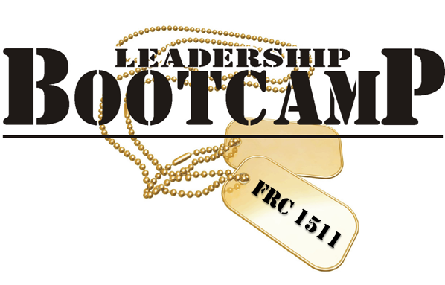
Training Students in Leadership
Larry Lewis & Leann Lewis
Penfield, NY
2015 FIRST Championships
Notes:
Do brief intro – we’re not teachers
Ultimately this is about why student leadership is important on your team and how it will maximize your students’ experience on your teams and make your teams better and stronger as a whole. Leadership Boot Camp is just one way to get to that goal.
Set up agenda – we’ll go over topics about how to train students in leadership and get them wanting to take on leadership roles and then we’ll have time at the end for questions.

Slide 2
Importance of leadership
Provides students with self-confidence
Allows them to practice in a safe environment
Helps build your team
For anyone!
Notes:
Leann:
All students, not just your leadership students should be included. And even mentors. We’ve even had the principal and the Leadership Seminar teacher sit in for part of it.

Slide 3
Assessing Your
Team’s Needs
Reflection – identifying opportunities to improve
Team Surveys
Lessons Learned (end of season or after major event)
Analyze your team’s strengths and weaknesses
Decide what are your team’s goals (long term and short term)
Determine tasks to accomplish goals
Determine how to divide up tasks
Decide your leadership structure
What roles do you need?
Who will fill them? (Mentors, Students)
Notes:
Larry
Lessons Learned to identify pros and cons
After different events
Competitions
End of the year
From survey and lessons learned analyze your strengths and weaknesses
Determine if you will hone your strengths or improve your weaknesses
Your goals will be determined by what strengths or weaknesses you want to improve
It is good to do long term and short term goals, long term = start 10 FLL teams in 2 years, short term = increase student recruitment
You need to determine what tasks you want to complete to achieve your goals and how to divide that amongst your team members

Slide 4
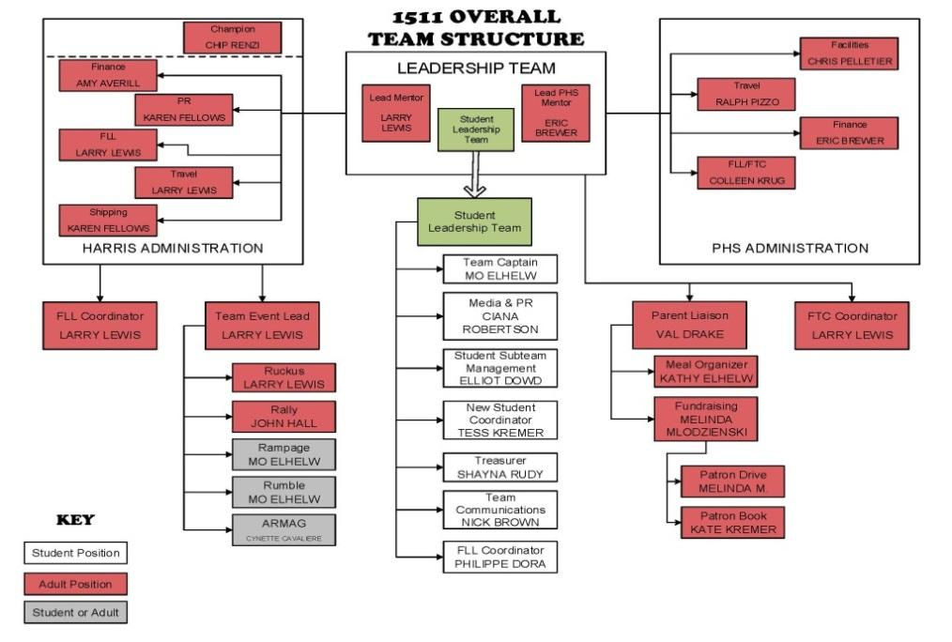
Team Structure
Notes:
Larry:
Once you’ve assessed your team’s needs, then you need to create a leadership structure that will combine the roles that are in charge of the tasks that need to be done.
As you can see here, we have figured out which roles can be fulfilled by a student. Some roles a mentor has to fulfill based on school rules, etc. Some roles may require a mentor to work with that student, but ultimately, we have initially identified leadership roles that students can do.
This structure is different for each season, preseason, build season, competition season

Slide 5
Leadership development
How do you get students to be leaders?
Create an environment that facilitates leadership
Let students make decisions, help steer the direction of the team
Legacy (carry the torch)
Team Building (promotes rapport and a positive environment)
Empowerment
Student-selected activities
Make students own the tasks
Mentors guide, not dictate
Notes:
Larry:
Part of the environment may be making activities mandatory in the beginning. Just like fundraising, leadership is necessary for the survival of your team. But also, just like FIRST, the students may not realize this is something they’re interested in until they try it.
Legacy - the idea of putting the onus on the students that it’s their job to carry the torch, but to also add their own lasting legacy to the team. Make them start thinking of ways to improve the team in multiple ways and help the team be successful in the future (video editing guide, safety program, MPT)
Team Building
Promote rapport and a positive environment so students feel comfortable leading within their team
Even fortune 500 companies do team picnics, team building activities – more likely to want to work together and toward the same goal
Benefits of Empowerment
May be a motivator for the individual
Increases total power of the team
Allows use of more people’s ideas and talents
Leaders have more time for vision and strategy
Leaders can focus on new tasks that they could not do before due to being overwhelmed
You still need to monitor your students and guide them.
Empowerment – encourage students to take ownership of the different tasks, hold them accountable for them. Periodically check in on them. Let them figure out the solutions to those tasks. Don’t dictate how they do the task. Yes you may do it a different way or have a different approach, but if the results are the same, it doesn’t matter because then the students are really learning a lot of great skills along the way, even if they make mistakes. As a group, clearly define what the results should be. Encourage delegation and other student (not just leaders, because then you end up with a core group of students doing everything) to assist with necessary tasks for bigger projects (i.e. a FLL camp, offseason event).

Slide 6
Leadership Development
Leadership subteam
Periodic leadership trainings
Provide opportunities to lead
Run team meetings
Organize robot demo, community service, and fundraisers
Public speaking (sponsors, at events, schools)
Notes:
Larry:
During your weekly leadership meeting make sure you set an agenda. This keeps the meeting productive and on time. I usually work with my team captain to establish an agenda prior to the meeting. This keeps the students involved. Make sure you assign a student to take meeting minutes and have them send them out after the meeting is over. You won’t be able to make progress unless you can document the decisions and tasks determined the week before. Work together toward leadership opportunities opportunities, have students lead different initiatives (doesn’t happen if students don’t lead it)
Establish roles that make sense for your team. We’ve adjusted these roles each year, depending on what we’ve evaluated that our team needs. Student Coordinator, School Liaison, Events Coordinator. It doesn’t have to be the traditional roles. The tasks of each role, and possibly when each task needs to happen (preseason, build, etc.) are critical in helping to guide your student leaders.
Have veteran leaders train new leaders. Don’t make your leadership team all seniors. This doesn’t allow for any cross training of the younger students. We have students from all grade levels represented on the leadership team.
Empowerment – encourage students to take ownership of the different tasks, hold them accountable for them. Periodically check in on them. Let them figure out the solutions to those tasks. Don’t dictate how they do the task. Yes you may do it a different way or have a different approach, but if the results are the same, it doesn’t matter because then the students are really learning a lot of great skills along the way, even if they make mistakes. As a group, clearly define what the results should be. Encourage delegation and other student (not just leaders, because then you end up with a core group of students doing everything) to assist with necessary tasks for bigger projects (i.e. a FLL camp, offseason event).

Slide 7
Leadership Motivation
Motivation Feedback Loop to promote student leadership
Need creates desire to fulfill needs (achievement through student leadership)
Behavior results in actions to fulfill needs (organizing event)
Rewards satisfy needs: intrinsic or extrinsic rewards (event goes well)
Feeling good about accomplishment
Notes:
Larry
When complete introduce Philippe our Team Treasurer and Austin our FIRST Event Coordinator

Slide 8
Student Presentations
Philippe – Team Treasurer
Austin – FIRST Event Coordinator
Notes:
Ask them what we want to list their title as
Let people clap for students

Slide 9
Keeping students
on Task
Delegate manageable tasks
Identify the criteria for success (provide clear expectations)
Provide available materials/resources
Accountability
Make the students their own judge of how well they’re doing (reflection, lessons learned)
Develop trust with the students to get the tasks done
Notes:
Larry:
Delegating tasks to students that you know they can handle, breaking larger tasks down into manageable pieces
Identifying the criteria for success
Letting them know what materials or resources are at their disposal
Identifying how they’ll be measured or graded on their success
Developing a trust with the students that they’ll get the tasks done. – sense of mentors/team are depending on them

Slide 10
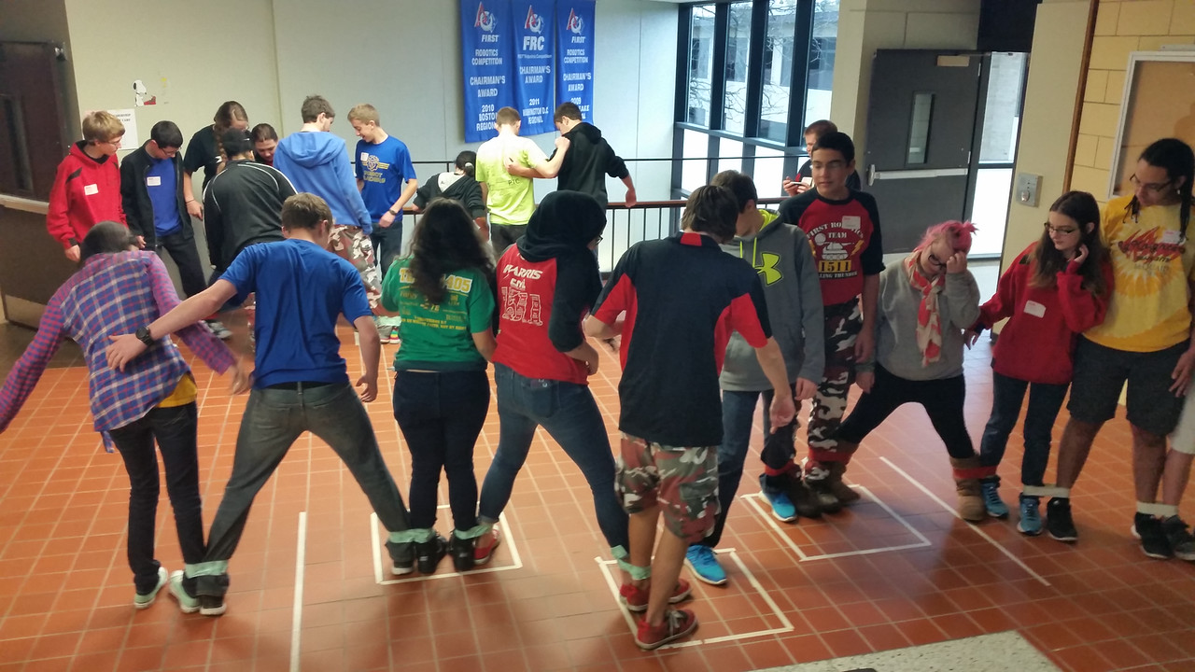
Leadership Boot Camp
Homework
Surveys (feedback)
All materials on our website!
Research
Make it Fun
Workbook
Notes:
Leann:
If you don’t have all day, you can break down into smaller topics/trainings.
It’s very difficult to convince a bunch of high schoolers to come back to school on a Saturday and learn for 6 hours, unless they’re building a robot!
Need to find ways to make it fun. And also change it up every year so it’s beneficial for students to go year after year. We’ve done activities such as the human knot (easy, so set up or supplies needed), the helium straw, any kind of teamwork activity to get them up and interacting with each other. But you also want to provide or allow discussion to keep them interested and able to contribute their own ideas and encourage questions. It’s no fun to sit there listening to someone, especially when you have an idea or question to share.
And then you can turn practicing skills into activities, like giving an impromptu speech, or preparing a 5 minute presentation.
Also provide other media like speeches, videos, movies. We’ve done part of the Last Lecture, part of Steve Jobs’ commencement speech at Stanford, and even shown 12 Angry Men at the end of the day and ordered chinese for dinner.
And as most of you have learned, the biggest motivator for students is food. Especially if you are planning a day-long camp, you will need to provide food of some sort. We usually bring in donuts and then order pizza and sodas for lunch. I also like to put little bowls of M&Ms or tootsie rolls or something on the tables so that they can snack and stay alert.
Breaks are important! They don’t have to be long, but we never try to go more than 1 hour of straight lecture without at least a 5 minute break. This helps keep their attention, allows them to go to the bathroom, get a drink, stretch, etc. Keep in mind most of their classes don’t last 60 minutes, so they’re not used to sitting that long. 5 minutes is always adequate. 10 minutes allows them to get into conversations and it just makes the day go longer.
The most we’ve had is 24 students. Had to break up into four groups of 6 to make up for time. Time is really your indicator of how many students you can have or what kinds of activities you’ll be doing. If all students have to give a 2 minute speech, that’s 48 minutes plus time in between as they switch.

Slide 11
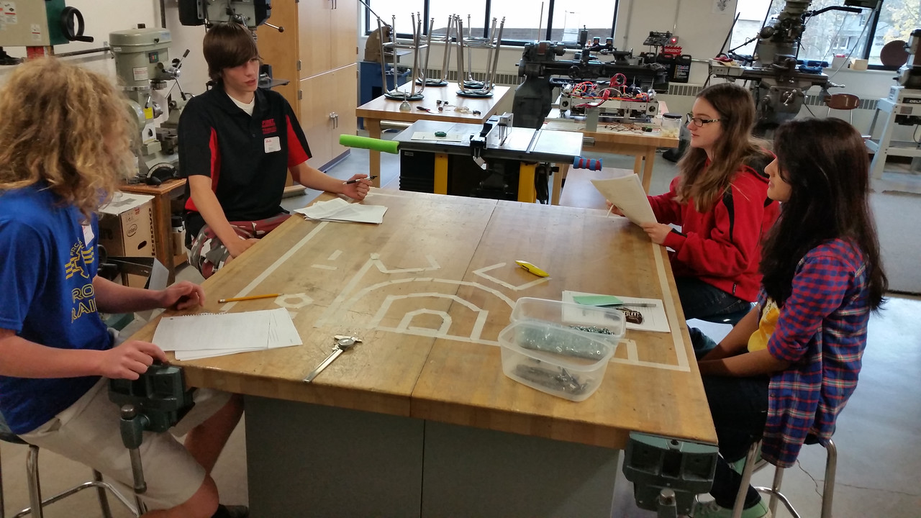
Leadership training Topics
Learning about strengths/weaknesses
How to use strengths to maximize team
Confidence
7 Habits of Highly Effective People
Communication
Presentation Skills
Motivation
Procrastination
Notes:
Leann:
Reinforce the idea of continuing to train students in leadership and keep them excited about it.
These are the topics that we’ve learned have been helpful and interesting over the years.
It’s important to identify the topics that are important and helpful to your students and team. You could teach for months about a million different leadership topics. (ties back to assessing team’s needs)
It is good to exercise some introspection and perform some activities that can give people insight into their strengths and weaknesses.
Once you know your strengths you can then figure out how to use them best on a team to complement the strengths of others on your team.
Confidence is especially important for building self esteems so that they feel secure with their abilities to lead tasks and voice their opinions
7 Habits is a great book by Steven Covey. The habits are great for future leaders to learn and practice to not only help you on your team but help them in life. (Be Proactive, Begin with the End in Mind, Put First Things First, Think Win-Win, Seek First to Understand then to be Understood, Synergize, Sharpen the Saw, Find your voice and encourage others to find theirs
Communication is one of the most important skills in FIRST and in life. Whether it is team emails to get your team all on the same page, or practicing empathic learning to understand someone's ideas during brainstorming.
Giving the students the chance to practice presentation skills is really important. This can be on a weekly basis by having students do announcements or lead activities at team meetings. Or more formal speeches at demonstrations or even presenting Chairman’s
Motivating students can sometimes be difficult. Finding out what drives them and reinforcing that interest will help them stay productive on your team.
I think procrastination is the one of the worst habits that people get into. Unfortunately everyone has done it at some point. The best way to combat it is to come up with habits or incentives to get your work done early and on time. One trick I used to use when I was in high school was that I would only let myself play video games if I got my homework done first.
You could start by duplicating our boot camp and then modify for the next time. Or do a survey ahead of time to see what your students would like to learn about, or do an informal poll, have general conversations with students, talk to your leadership group if you have one (which you should!).

Slide 12
References
The 7 Habits of Highly Effective People - Stephen Covey
The Six Pillars of Self Esteem - Nathaniel Branden
Developing the Leaders Around You - John Maxwell
Learning the 21 Irrefutable Laws of Leadership - John Maxwell
Leadership - Rudy Giuliani
Strengths-Based Leadership - Tom Rath
Introduction to Leadership Concepts and Practice - Peter Northouse
Notes:
Leann:
There’s a ton of other books by these particular authors and many other books you can read. These are some of the materials that Leann and I have used for material for the leadership boot camp.
autobiographies by some great leaders are interesting reads and have a lot of good info or examples of real life application of leadership skills - great recommendations for your students

Slide 13
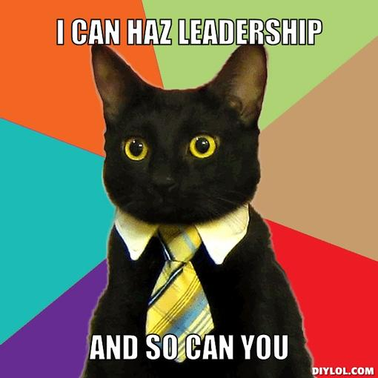
Take Home Messages
Assess your team’s needs (periodically)
Create a positive leadership environment
Empower your students
With strong leadership, you will maximize your team’s abilities
All students can be leaders
Notes:
Leann:

Slide 14
Questions?
Contact us!
leann324@gmail.com
larrylewis1511@gmail.com
http://penfieldrobotics.com/team/Leadership

